Slide 1
Please submit all history, discussion, references, etc.
as a separate Word or text file.
Please submit all captions in the space below where it reads:
“Click to add Notes” or “Insert Caption Here”
Notes:
Insert Caption Here

Slide 5
Some arrows you can use

Slide 6
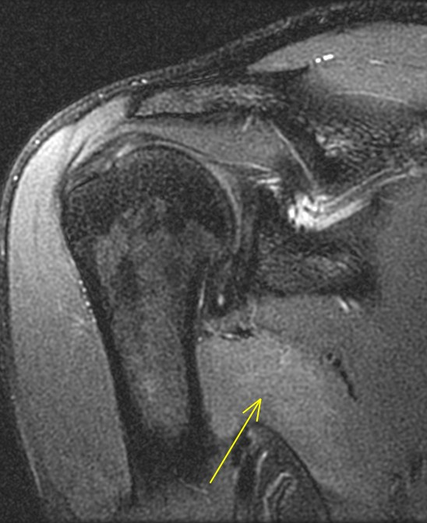
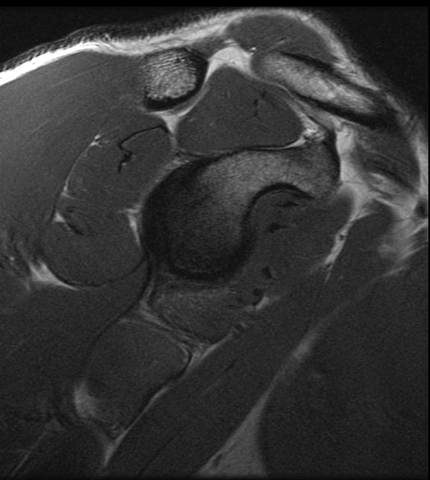
Example slide
A
B

Slide 7
Example slide
A
B
C
D
Day 1
20 days later
20 days later
D
E
F

Slide 8
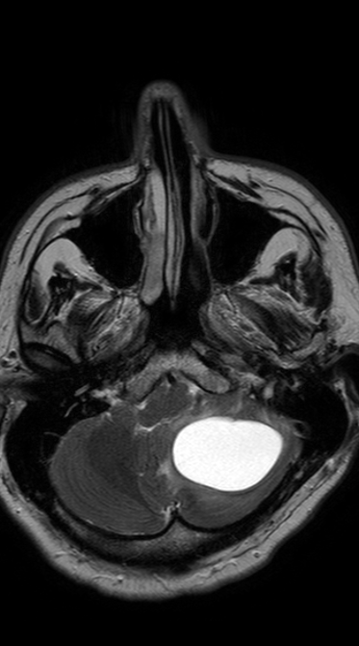
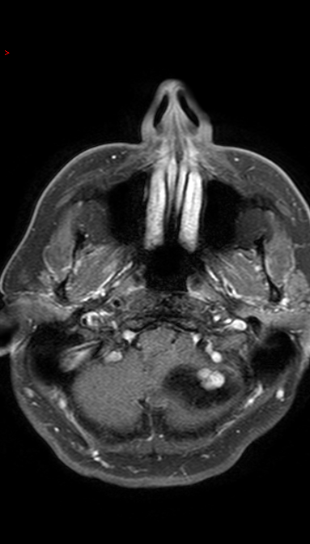
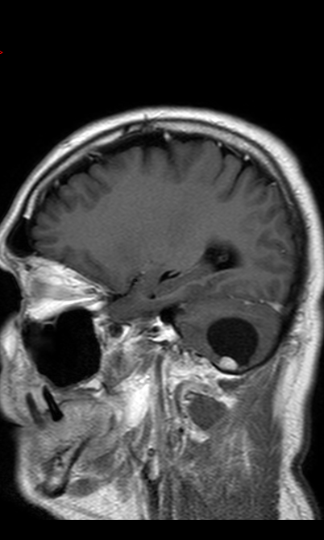
T2WI
T1WI + C
T1WI + C
Example slide
A
B
C

